Slide 1
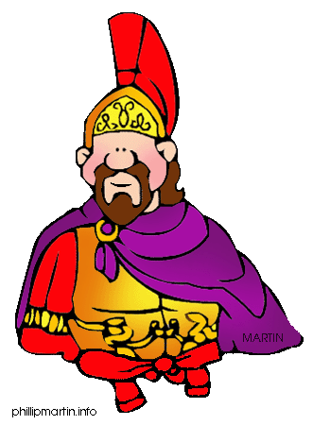
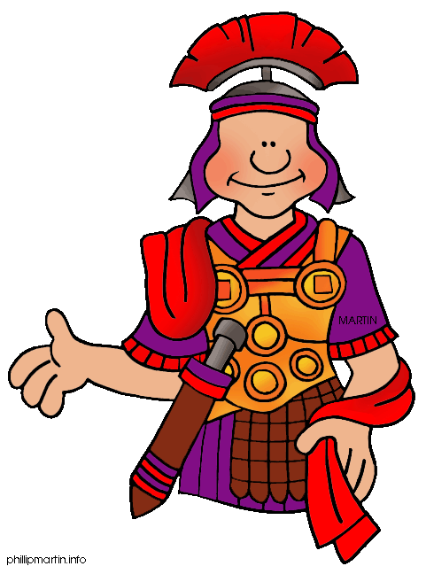
marching
All Romans
Marching, marching, marching all the way,
Roman soldiers bringing news today.
Listen up to what we have to say,
Caesar Augustus RULES – OK!! (2 TIMES)
(Repeat)
Marching, marching,
Marching, marching,
Marching, marching,
Chief Roman
HALT!

