Slide 1
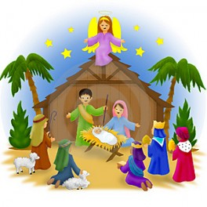
We sing of the birth
We sing of the birth of a baby King,
The prophets foretold of this wonderful thing.
God’s greatest gift comes from heaven to earth,
Bringing the promise of peace with His birth.

