Slide 1
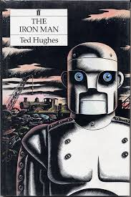
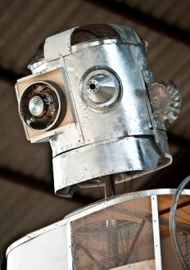
The Iron Man
Carter & Sky

Slide 2
Chapter 1
The Iron man walked to the edge of the cliff and walked of it. As he fell down his parts of his body fell off .There was silence only one had move and started to collect all the pats for iron man. Then he started to build himself up and walked in the water till he disappeared .

Slide 3
Chapter 2
One day a boy called Hogarth was fishing in a pond he and then he looked up at the cliff there was to headlamps so he ran home to tell his family his father got his gun and went around to warn the neibours that a giant was near. The next morning all the famers machinery was gone and there was half eaten tractor so they got together and decided to dig a big hole to trap the iron man . Days went on day after day they thought the Iron man would not come back. So one night Hogarth thought he could catch a fox . But the Iron man came luckily he had a nail and a knife in her pocket and he put them together and that attracted the Iron Man and he fell in the hole

Slide 4
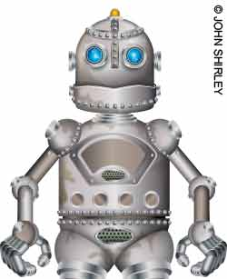
Link Below has a video a the iron man
http://www.bbc.co.uk/learningzone/clips/ted-hughes-the-iron-man-extract/5320.html

Slide 5
Chapter 3
A year has passed since the iron man has been buried by Hogarth's dads farmers Hogarth felt sad since he was the one that trapped the iron man *

