Slide 1
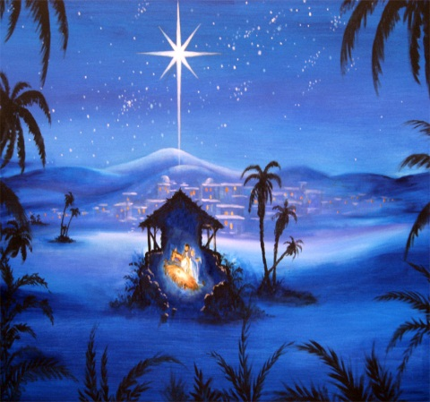
Run with haste to Bethlehem
We heard the angels singing and we wondered what to do,
Run with haste to Bethlehem.
We told the other shepherds of their joyful Christmas news,
Run with haste to Bethlehem.
We saw the bright star shining, lighting up the way,
Run with haste to Bethlehem.
It pointed to the stable where the special baby lay,
Run with haste to Bethlehem.

Slide 2
The stable door was open and they told us to come in,
Run with haste to Bethlehem.
Everyone is welcome to see this little King,
So run – (All shout RUN!) – run – (RUN!) –
run – (RUN!) – run – (RUN!)
Run with haste to Bethlehem.

