Slide 1
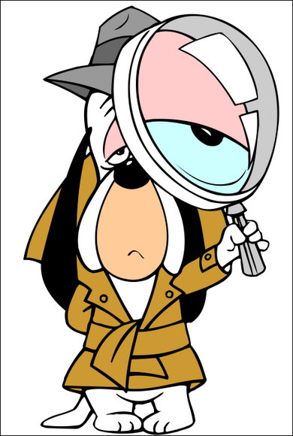
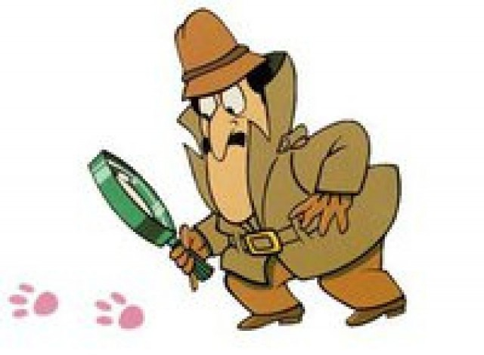
Primary 3 WHO DUNNIT?

Slide 5
Security Camera

Slide 6
SUSPECT 1

Slide 7
SUSPECT 2

Slide 8
SUSPECT 3

Slide 9
SUSPECT 4

Slide 10
SUSPECT 5

Slide 17
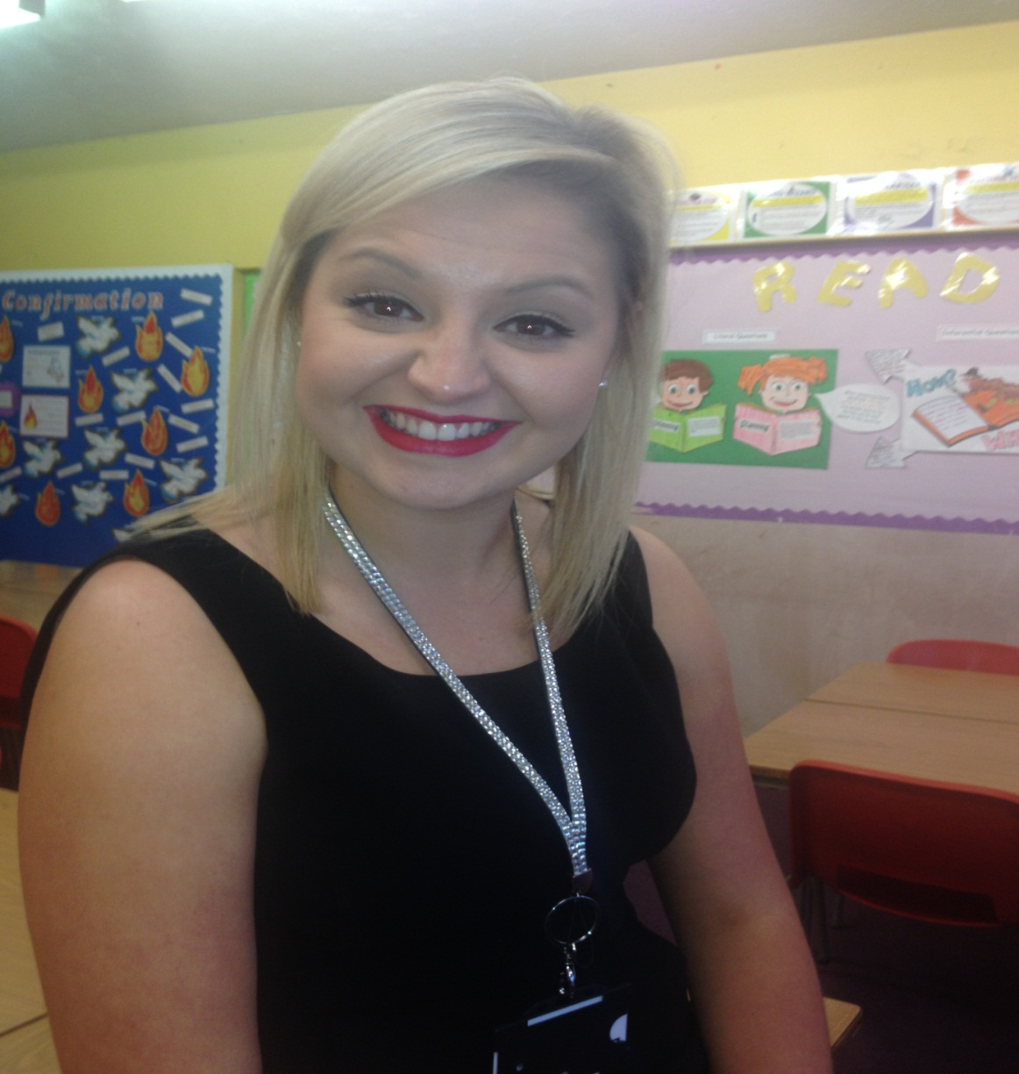
SUSPECT 1

Slide 23
Microscopes

Slide 27
What do you think this is?

Slide 28
It is…BREAD

Slide 29
What do you think this is?

Slide 30
It is…SUGAR

Slide 31
What do you think this is?

Slide 32
It is…HAIR

Slide 33
IT WAS…

Slide 34
GUILTY!!!!!

Slide 35
