Slide 1
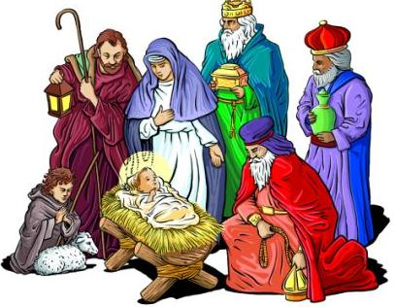
Now our story has been told
Now our story has been told,
We have seen it all unfold,
And the jigsaw has reminded us today
How Joseph found the way
To a stable far away
And Mary bore God’s Son on Christmas Day.
CHORUS
Christmas bells ring out across the ages
And the message is clear,
Wishing you a very merry Christmas,
And a happy New Year!

Slide 2
Now our story has been told,
We have seen it all unfold,
And the jigsaw has reminded us today.
Shepherds heard the angels sing,
And a bright star led the kings
To Jesus in a manger full of hay.
CHORUS
Now our story has been told,
We have seen it all unfold,
And the jigsaw has reminded us today
To stop and think awhile
Of this very special child
Who was born to be the light, the truth, the way.
CHORUS x 2 + Alleluia descant
Repeat last line

