Slide 1
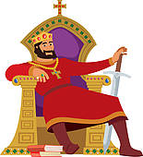
Herod!
(Intro – finger clicks)
He’s Herod! Herod, the king of Judea,
The king who rules with the power of fear,
In his great white palace in Jerusalem
His servants try to please him but they’re nervous men!
Now Herod has wives, some dark and some fair,
He’s commanded them to give him the perfect heir,
But if a baby doesn’t suit him, then in one breath
He’ll snarl
(Herod, spoken) It’s a reject, put the child to death!
The people in the city simply hate this man,
They’re waiting for God to come up with a plan.
They need a Messiah to save the day
And bring a little peace with Him along the way.

Slide 2
So imagine the scene: there’s a star in the sky,
And three wise men come strolling by.
They stop at Herod’s palace, a natural thing
If you want to find a baby who’s a brand-new King.
(finger clicks)
People gather round with a glint in their eye,
For the palace is the web and these men are the fly.
King Herod is the spider,
waiting for his prey,
The wise men will be dead
meat today!

