Slide 1
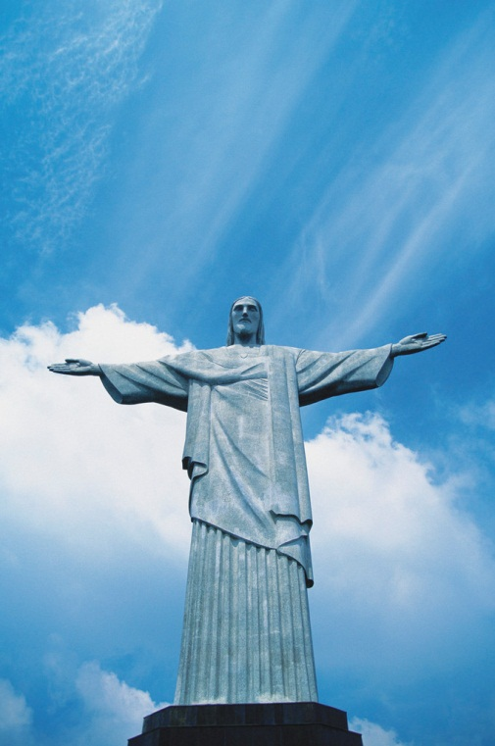
Holy Week
Betrayal, death and resurrection of
Jesus

Slide 2
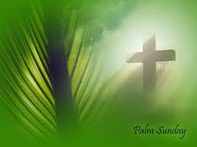
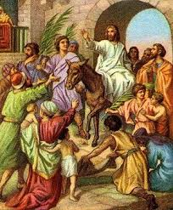
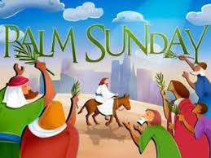
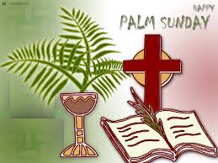
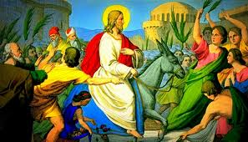
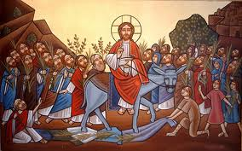
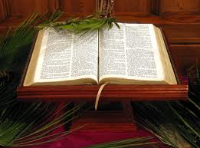
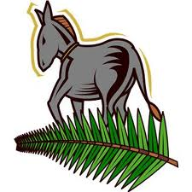
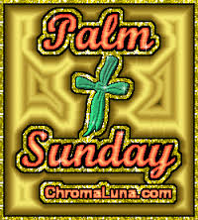

Slide 3
Palm Sunday
Palm Sunday is the sixth Sunday of Lent and the last Sunday before Easter. It is also known as Passion Sunday, Willow Sunday, and Flower Sunday.
Palm Sunday commemorates the triumphal entry of Jesus into Jerusalem, where he would be crucified five days later.
According to the Gospels, Jesus rode into town on a donkey as exuberant crowds hailed him as the Messiah and spread out palm branches and cloaks in his path.
The event commemorated on Palm Sunday is told in all four gospels (Matthew 21, Mark 11, Luke 19, John 12).

Slide 4
Palm Sunday continued
The Matthew narrative, the one most commonly read in services on Palm Sunday, tells the story this way:
As they approached Jerusalem and came to Bethphage on the Mount of Olives
Jesus sent two disciples, saying to them, "Go to the village ahead of you, and at once you will find a donkey tied there, with her colt by her.
Untie them and bring them to me. If anyone says anything to you, tell him that the Lord needs them, and he will send them right away...

Slide 5
Palm Sunday continued
The disciples went and did as Jesus had instructed them. They brought the donkey and the colt, placed their cloaks on them, and Jesus sat on them.
A very large crowd spread their cloaks on the road, while others cut branches from the trees and spread them on the road.
The crowds that went ahead of him and those that followed shouted, "Hosanna to the Son of David! Blessed is he who comes in the name of the Lord! Hosanna in the highest!“
When Jesus entered Jerusalem, the whole city was stirred and asked, "Who is this?" the crowds answered, "This is Jesus, the prophet from Nazareth in Galilee." (Matthew 21:1-3, 6-11)

Slide 6
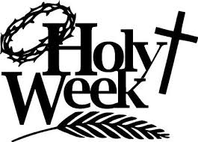
Holy Monday
Jesus had a very busy week during His last week on earth known as Holy Week or Passion Week
Jesus had ridden into Jerusalem on Palm Sunday and the people lined the road with their cloaks and palm leaves. As Jesus rode into Jerusalem on a new donkey that had never been ridden before, He wept over the devastation of Jerusalem
Cara & Jenna

Slide 7
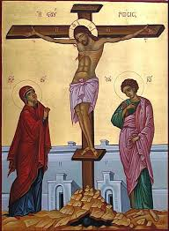
Holy Monday continued
Jesus cursed the barren fig tree.
Jesus was hungry and he went to the fig tree to get something to eat, but when He approached it, He saw that it was barren. It was not the time for figs, but it was understood that once a fig tree had leaves, it should also have figs.
Cara & Jenna

Slide 8
Holy Tuesday
On Tuesday morning Jesus returned to Jerusalem. They passed the withered fig tree on their way and Jesus taught them about faith
Jesus entered the temple courts and while he was teaching the chief priests and the elders of the people came to him .By what authority are you doing with these things? They asked and who gave you this authority.
Cara & Jenna

Slide 9
Holy Wednesday
Holy Wednesday, also known as Spy Wednesday, is the Wednesday of Holy Week, the week before Easter.
It is known as “Spy Wednesday” as a reference to the betrayal of Jesus by Judas Iscariot.

Slide 10
Holy Wednesday continued
Judas was disappointed with Jesus teachings.
Judas went to see the Jewish leaders and offered Jesus location.
In return for the information he was given 30 silver coins.

Slide 11
Holy Wednesday continued
Meanwhile, Jesus visited a man called Simon who suffered from a terrible skin disease.
Whilst Jesus was eating a woman came in with a jar to anoint him.
Jesus told the disciples this was to prepare him for burial.

Slide 12
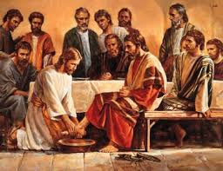
Maundy Thursday
On the night before his death Jesus had a final meal with his friends.
Before the Passover Jesus surprised his friends by washing the feet of every person, a task that was normally done by a servant.
He wanted to show his followers that they should love one another in humble ways
Lauren & Jennifer

Slide 13
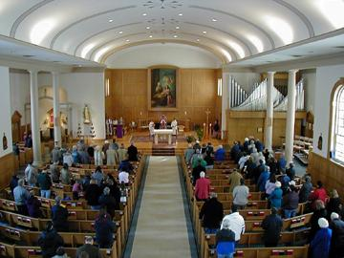
Maundy Thursday continued
Maundy Thursday means holy Thursday
Maundy Thursday is on April 17th this year
Christians around the world and across many countries take time on this day to remember the Last Supper.
Lauren & Jennifer

Slide 14
Bible reading
Maundy Thursday
After he had washed their feet, had put on his robe, and had returned to the table, he said to them, "Do you know what I have done to you? You call me Teacher and Lord—and you are right, for that is what I am. So if I, your Lord and Teacher, have washed your feet, you also ought to wash one another’s feet. For I have set you an example, that you also should do as I have done to you. Very truly, I tell you, servants are not greater than their master, nor are messengers greater than the one who sent them."
John 13:12-16
Lauren & Jennifer

Slide 15
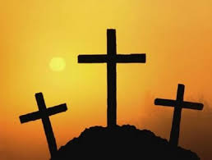
Introduction
Good Friday is well remembered by many Christians across the globe for Jesus was crucified that day. He was nailed to the cross next to two thieves. That is why there are crosses in the church during Holy Week.
Peter And Caitlin

Slide 16
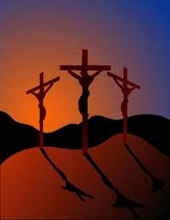
Good Friday
Jesus was crucified at a hill called Golgotha (the place of skull).
He was nailed to the cross by roman soldiers and later died later that day around 3pm.
Christ was crucified next to two thieves, one on either side.

Slide 17
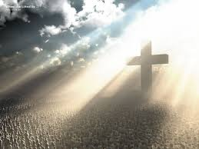
Good Friday Continued
At Easter people eat hot cross buns which have a cross shape top.
It is a very sad day in the church so there are no flowers or decorations.
The church is left dark and there is only a cross on the alter.

Slide 18
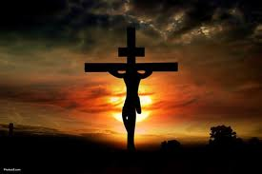
Bible Reading
And as they came out, they found a man of Cyrene, Simon by name: him they compelled to bear his cross.
And when they were come unto a place called Golgotha, that is to say, a place of a skull,
They gave him vinegar to drink mingled with gall: and when he had tasted thereof, he would not drink.
Mathew 27:32-61

Slide 19
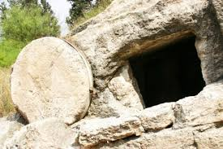
Holy Saturday
This year starts on April 19th
Holy Saturday is sometimes known as Easter Saturday
It is also known as Easter Eve or Black Saturday
This signifies the day that Jesus Christ’s body was put into the tomb
By Connor mcl and ben

Slide 20
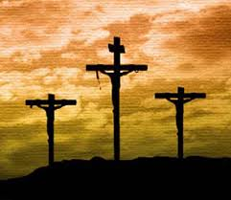
Holy Saturday continued…
Easter Saturday is the Saturday before Easter and the end of Lent
Many churches hold services on this special day
Holy Saturday commemorates the day that Jesus laid in the tomb
By Connor and Ben

Slide 21
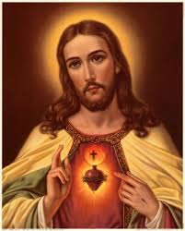
Holy Saturday continued again…
Jesus descended hell and set the captives free.
Jesus was put to death while soldiers were guarding his tomb
By Ben & Connor

Slide 22
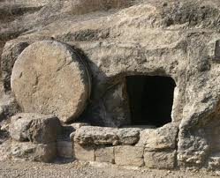
Easter Sunday
After being crucified, Jesus lay in the tomb for two days
Early Sunday morning, Mary Magdalene and some other women went to the tomb with the spices they had prepared
When they arrived, they found the tomb had been opened already. When they went in, they did not find Jesus' body, and they wondered what had happened.
Alice & Emma

Slide 23
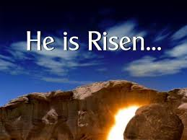
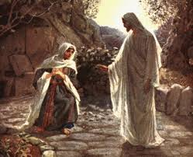
Easter Sunday continued
Mary Magdalene was confused, but then she heard a man’s voice from behind her. She turned around to see a familiar face.
It was Jesus! He had Risen!
Jesus said “Don’t hold on to me ,i have not yet returned to the father but go to my disciples and tell them I am ascending to heaven”
Mary Magdalene went and said to the disciples, “I have seen the Lord”
Alice & Emma

