Slide 1
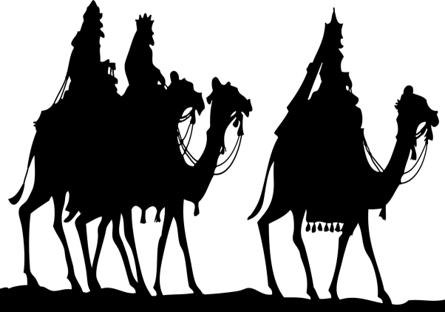
Going on a journey
Going on a journey,
A little holiday,
Looking up our relatives,
We hope they’ll let us stay.
We will still be working,
With all the kids to mind!
It won’t be such a holiday
For women you will find!
CHORUS Men
Packed up and on our way,
Women
We will be back one day,
Romans
Start now and don’t delay,
All
The Emperor is waiting!
(Repeat)

Slide 2
Wives
2 Going on a journey,
We’re walking all the way.
Robbers might be hiding there
To ambush us today!
Husbands
Going on a journey,
A census has been called.
Romans give the orders now
And can’t be overruled.
CHORUS
The Emperor is waiting!

