Slide 1
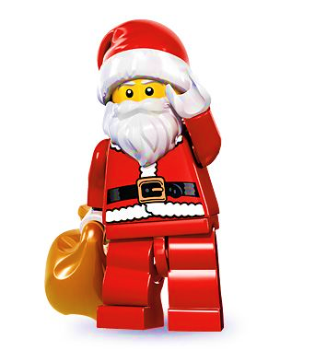
The forgotten toys
CHORUS Up in the attic, all alone,
Was a box of forgotten toys,
Once they were played with all day long
By long-ago girls and boys.
Joe and Tom
1 This train, with a track, goes round and round
With a toot and a puff of steam,
But the engine is scratched and scruff y now
And nobody winds the key.
CHORUS (All)
Meg, Eve and Beth
2 This old Teddy bear with a worn-out nose
Is waiting for Christmas Eve,
He’ll sit on your bed and guard all the toys
That Santa Claus will leave!

Slide 2
CHORUS (All)
Toy Seller
3 Here’s a jigsaw of wood in a battered box,
Which pictures the age-old scene
When Jesus was born in Bethlehem
In a stable poor and mean.
Toy Seller
CHORUS Will nobody buy my jigsaw dear,
It’s fi t for a girl or boy!
You’ll never forget your purchase here
With its message of Christmas joy,
With its message of Christmas joy!

