Slide 1
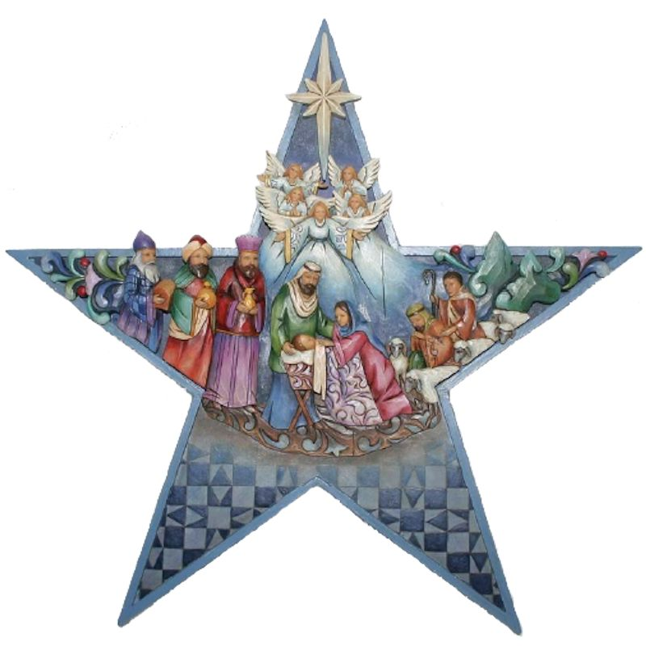
Follow the star
Follow the star,
Follow the star,
See it shining, oh so bright!
Follow the star,
Follow the star,
See it lighting up the night!
Never be afraid,
It will show you the way.
Follow the star,
Follow the star
Into Bethlehem tonight.

